Slide 1
Tweet Analysis and Sentiment Mining
Medhini Oak (1BM16CS047)
Aditi Awasthi (1BM16CS008)
Deepthi Bhat (1BM16CS003)
Under the guidance of Prof. Vikranth B.M
Assistant Professor, CSE Department

Slide 2
Aim of the Project
Developing a program for sentiment analysis is an effective computational measure for user perceptions. In this project, we extract the tweets based on their hashtags, analyze the various fields which come along with it and plot various graphs to visually present our findings. Furthermore, we also use Bing and NRC datasets to categorize the tweets into positive or negative (Bing) and in the categories of anger, anticipation, disgust, fear, joy, sadness, surprise or trust (NRC).

Slide 3
List of Functionalities
Extracting the tweets based on hashtag
Plotting frequency of tweets location wise and geocoding
Getting the frequency of statuses in the past 9 days
Plotting the frequency of tweets by two different news hubs
Building a Word Network
Bing Sentiment Analysis
NRC Sentiment Analysis

Slide 4
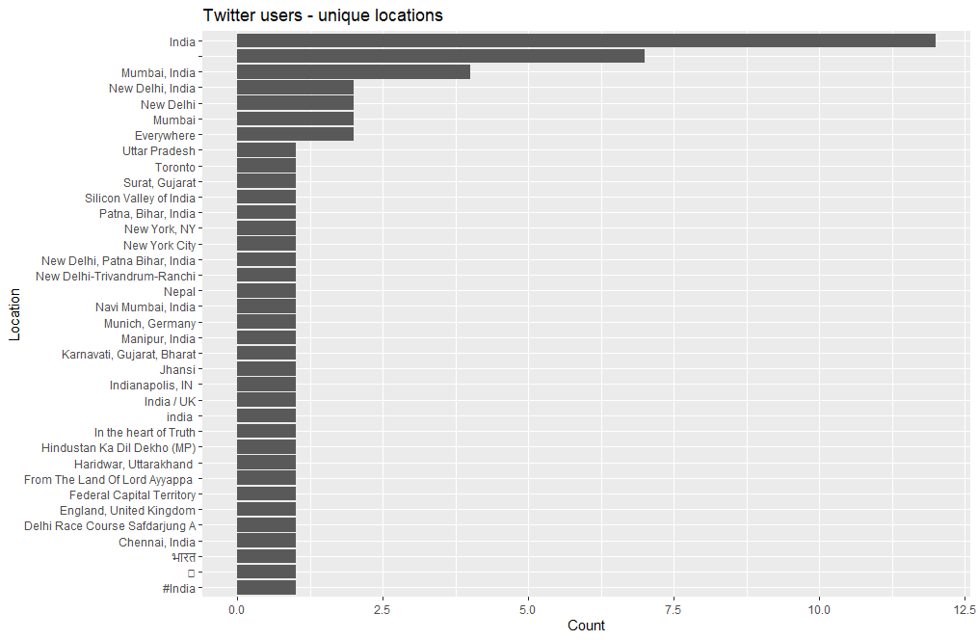
Visualisations

Slide 5
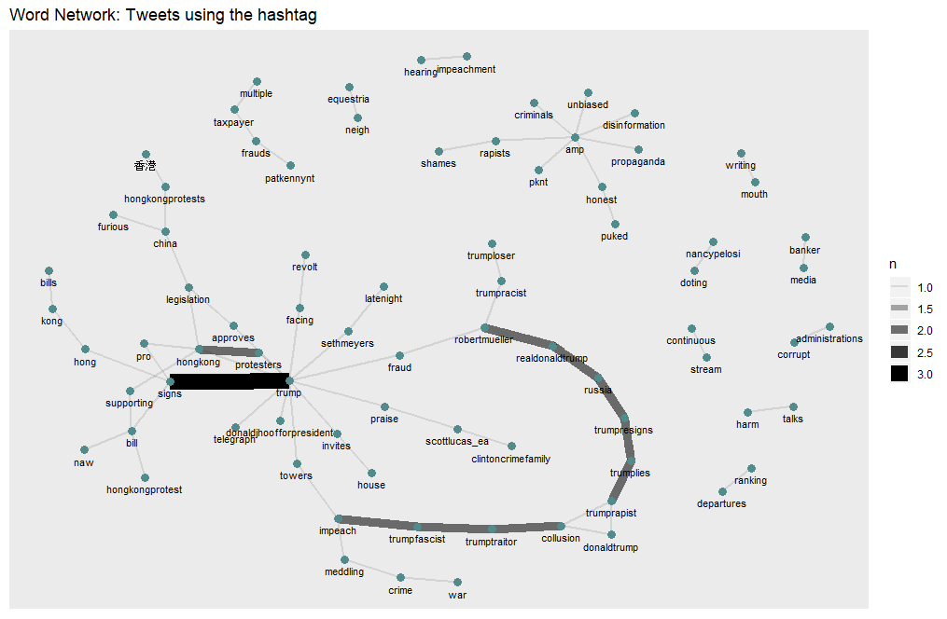
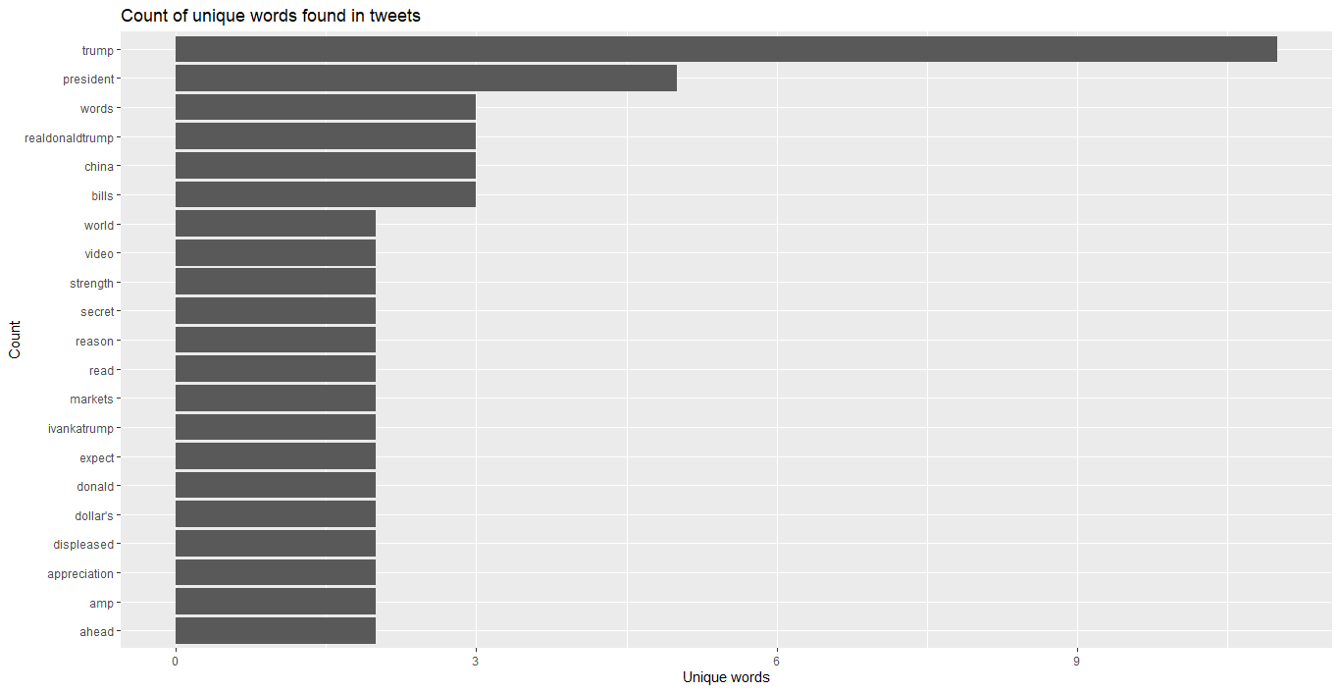
Visualisations

Slide 6
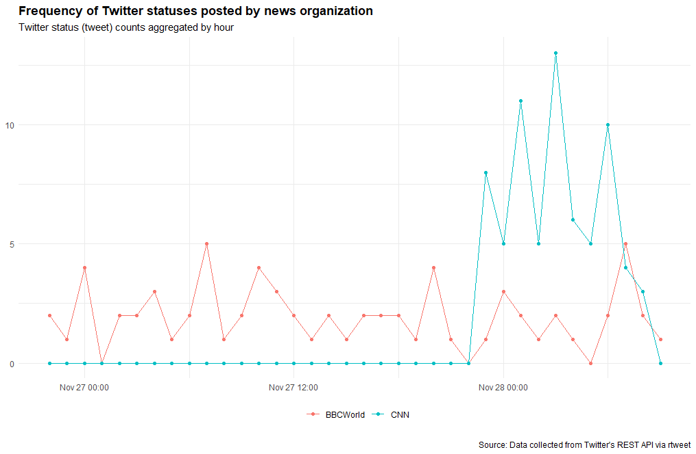
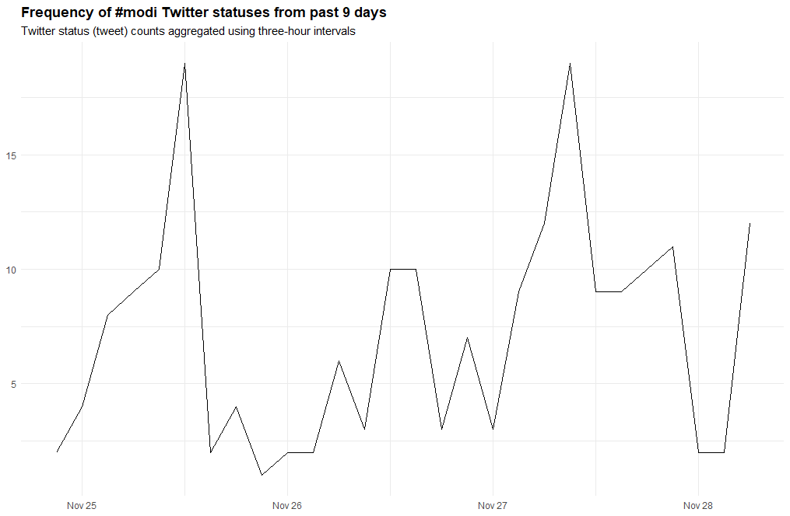
Visualisations

Slide 7
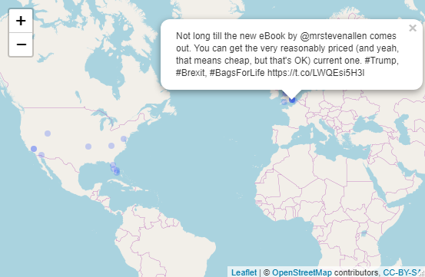
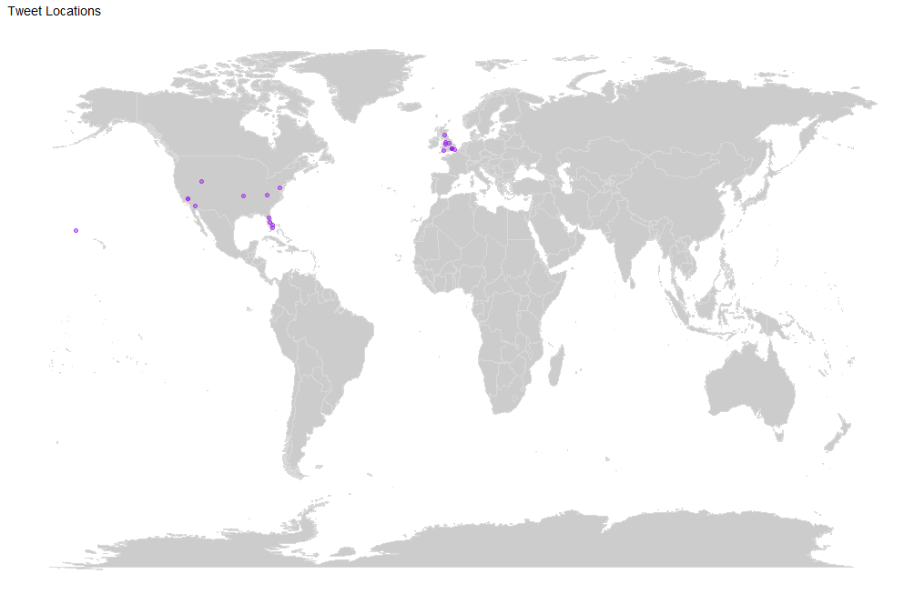
Visualisations

Slide 8
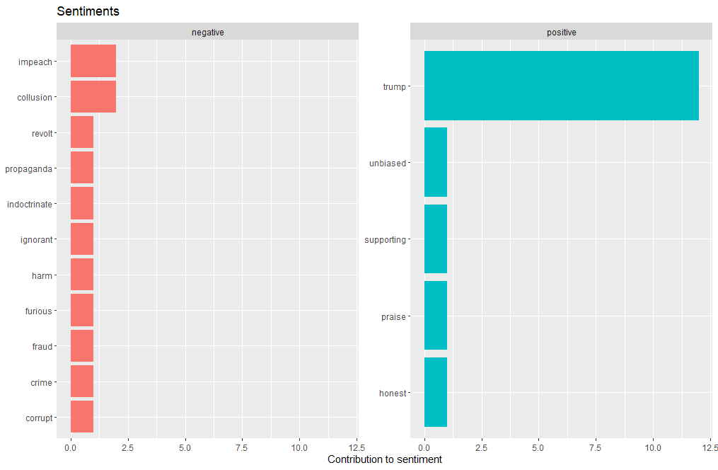
Visualisations

Slide 9
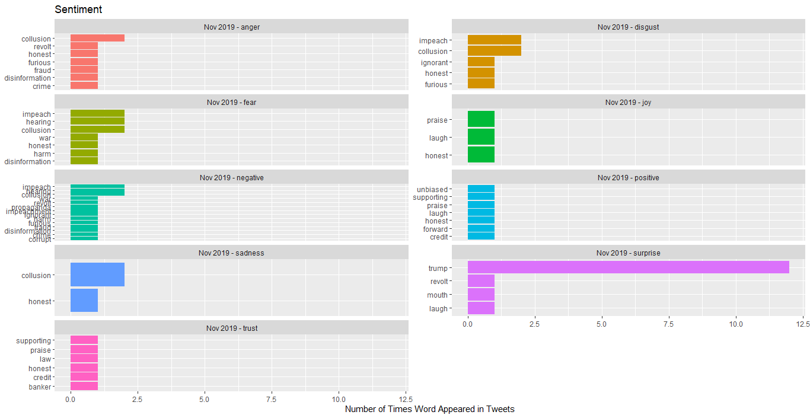
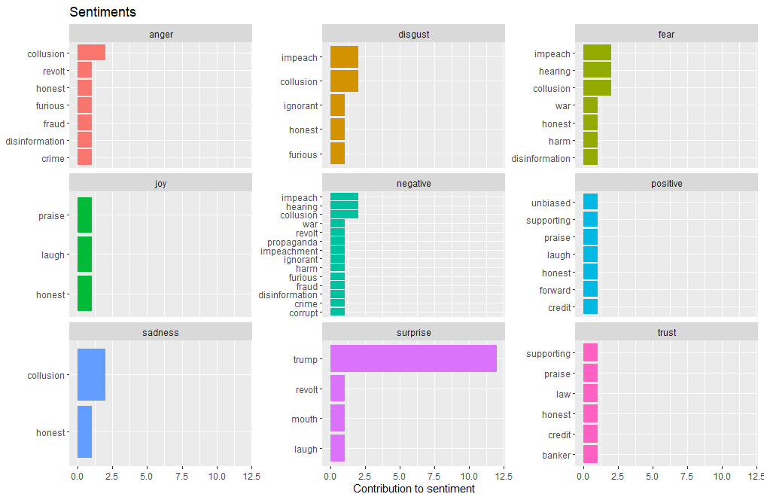
Visualisations

Slide 10
Results
This project can provide accurate public opinion about various socially relevant topics just by analyzing tweets from Twitter. It is also enables the user to visualize the results with the help of graphs, frequency charts and other visual aids. This project can be applied in various fields to draw appropriate conclusions. Some of them are:
Business: In the field of marketing, companies use it to develop their strategies, to understand customers’ feelings towards products or brand and how people respond to their campaigns or product launches.
Politics: In the political field, it is used to keep track of political view, to detect consistency and inconsistency between statements and actions at the government level. It can be used to predict election results as well.
Public Actions: Sentiment analysis also is used to monitor and analyze social phenomena, for the spotting of potentially dangerous situations and determining the general mood of the blogosphere.

Slide 11
Thank You

